Slide 1
CSC 362: System Programming
Lecture 8
Original slides by: Amitabha Dey
Adapted by: Dr. Richard Johnson
Department of Computer Science University of North Carolina at Greensboro

Slide 2

Status Check
Preprocessor directives
#define, #if, #ifdef, #ifndef, #undef
File Inclusion
<header.h>, header.h
What we will cover today
Compiling Multi-File Projects
Dependency Tracking
Makefiles
Structure
Common Targets
Variables and Pattern Rules

Slide 3
Multi-File C Projects Compiling Multi-File Projects
Header Files (.h):
Purpose: Header files contain declarations of functions, global variables, macros, and structures.
They provide the interface for other code files to use without knowing the implementation details.
In C programming, splitting source code into header files (.h) and source files (.c) is a common practice.
Why Split Source Files?
Modularity: Breaking code into smaller, more manageable files.
Reusability: You can reuse common functions and declarations across multiple files.
Separation of Concerns: Keep interface (declarations) separate from implementation (definitions).
Source Files (.c):
Purpose: Source files contain the definitions or the actual implementation of the functions and variables declared in the header files.

Slide 4
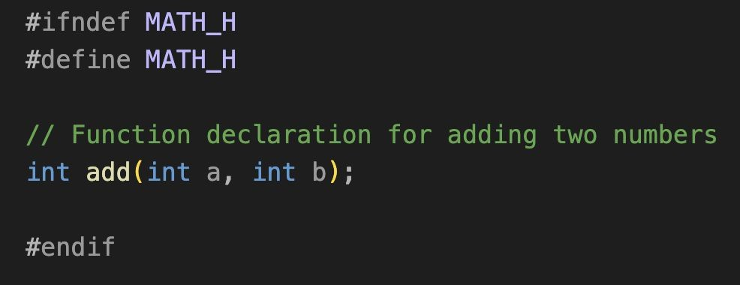
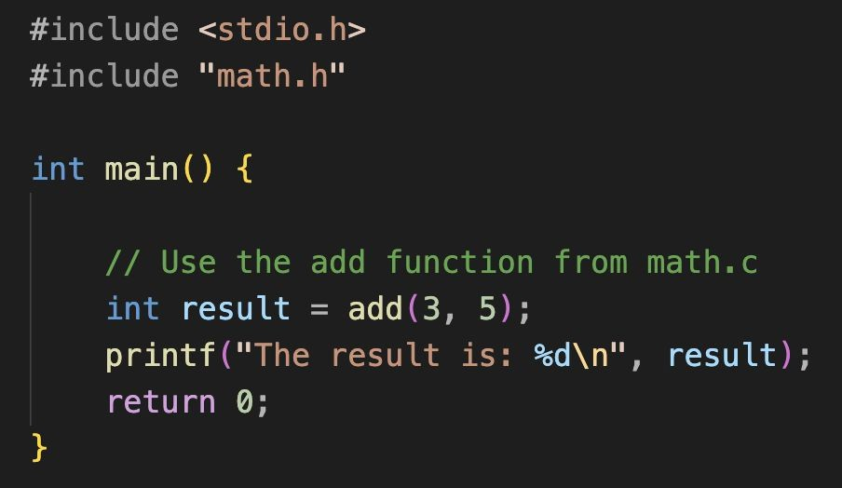
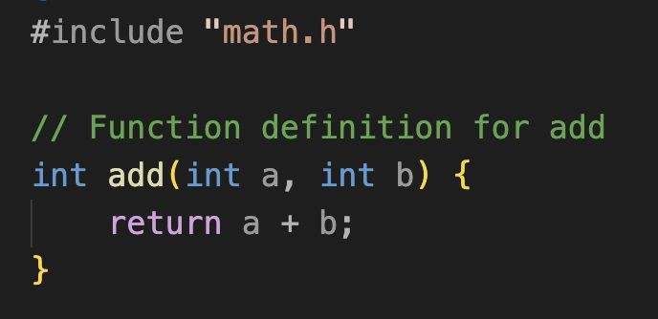
Multi-File C Projects Compiling Multi-File Projects
math.h
main.c
math.c

Slide 5
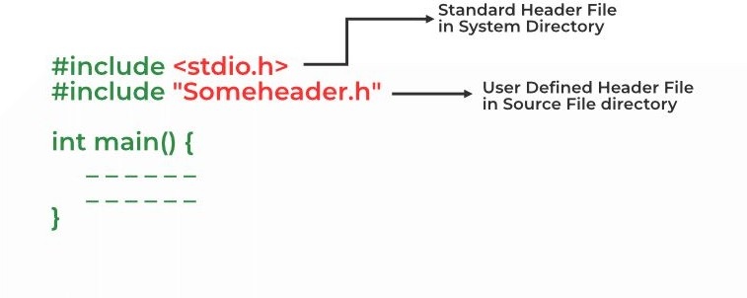
Multi-File C Projects
Source Files and Header Files
Source files (.c or .cpp): Contain the actual implementation of the program, including function definitions and logic.
Header files (.h): Contain function declarations, macros, data type definitions (e.g., struct, enum), and external variable declarations. They serve as the interface between source files.
Image credit - https://www.geeksforgeeks.org/

Slide 6
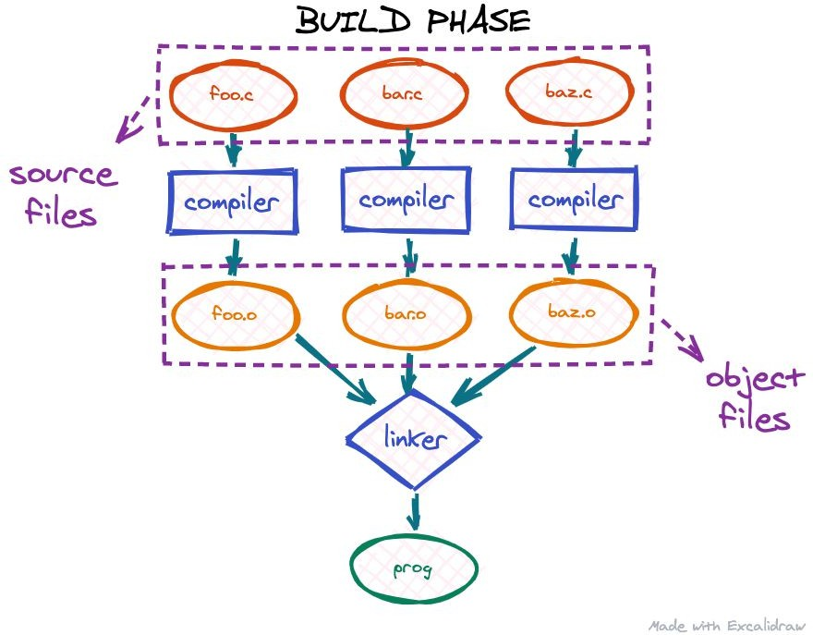
Multi-File C Projects
Object Files
When you compile a source file (.c), it is converted into an object file (.o). This object file contains machine code but is not yet an executable.
Object files are later linked together to create the final executable.
gcc file1.o file2.c -o myprogram
file1.o: This is the precompiled object file.
file2.c: This is the source file that is being compiled and linked in the same step.
-o myprogram: The -o option specifies the name of the output executable (myprogram).
Image credit - https://blog.cloudflare.com/

Slide 7
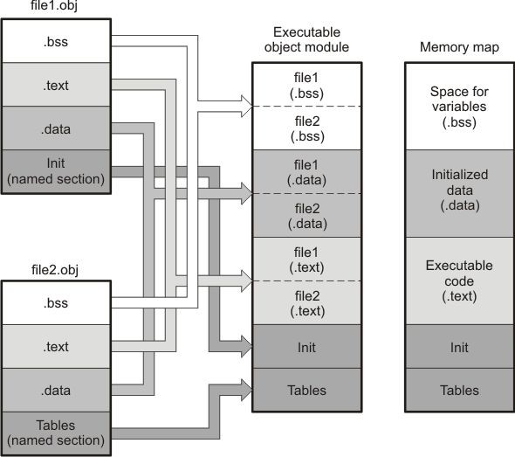
Multi-File C Projects Object Files
file1.obj and file2.obj have been assembled to be used as linker input. Each contains the .text, .data, and
.bss default sections; The executable object module shows the combined sections.
The linker combines the .text section from file1.obj and the .text section from file2.obj to form one .text section, then combines the two
.data sections and the two .bss sections.
The memory map shows the combined sections to be placed into memory.
Let’s look what’s inside a (.o) file!
gcc -c hello_world.c
objdump -d hello_world.o
Machine code: The .text section contains the actual machine code for the program. For example, 55 push
%rbp is the instruction to push the base pointer onto the stack.
Addresses: The
0000000000000000 <main>
indicates that the function main starts at address 0x0 in the object file.
Image credit - https://downloads.ti.com/
Notes:
---
For reference:
The .bss section (short for "Block Started by Symbol" or "Block Storage Start")
in an object file is used to store statically allocated variables that are uninitialized or explicitly initialized to zero.
The .data section holds initialized, non-zero global/static variables and occupies space in the binary file.

Slide 8
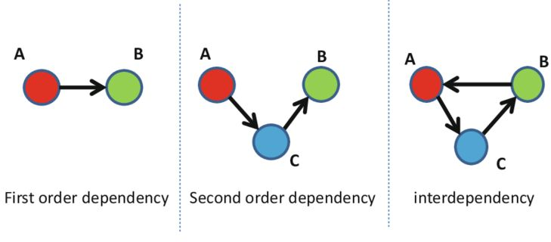
Multi-File C Projects
Dependency
If a source file (file.c) includes a header file (file.h), then file.c depends on file.h.
If file.h changes, file.c must be recompiled to reflect those changes.
Dependencies can be direct (when a source file directly includes a header) or indirect (when a header file includes another header).
Image credit - Setola, Roberto & Theoharidou, Marianthi. (2016). Modelling Dependencies Between Critical Infrastructures. 10.1007/978-3-319-51043-9_2.

Slide 9
Multi-File C Projects Dependency Tracking
When working with multiple files in a project, it's important to track which source files depend on which header files.
This is typically managed by a build system (such as make using a Makefile), which tracks file dependencies and determines which files need to be recompiled when changes are made.
When a source file, say main.c, includes a header file (#include "myheader.h"), it depends on myheader.h.
The build system knows that if either main.c or myheader.h changes, the object file main.o needs to be recompiled.
Each source file (main.c, myheader.c) is compiled separately into an object file (main.o, myheader.o).
The object file stores the compiled machine code and keeps track of its dependencies.

Slide 10

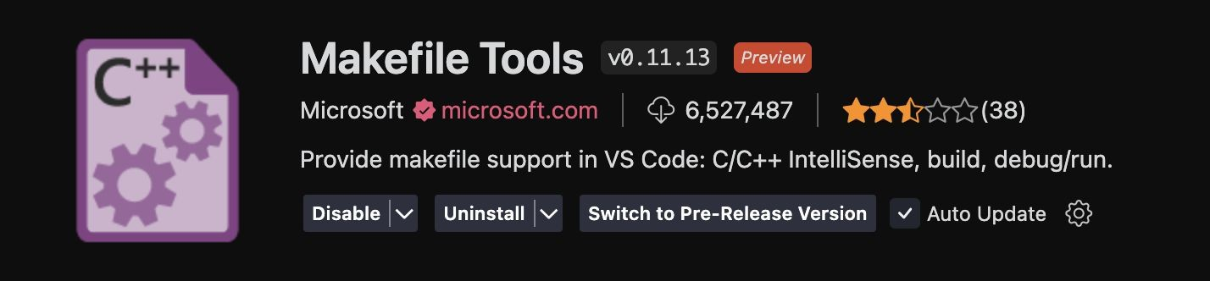
Makefile Tools
A Makefile is used to automate this process. It defines how files are compiled and linked, and it tracks dependencies so that only the necessary files are recompiled.
Install the extension:

Slide 11
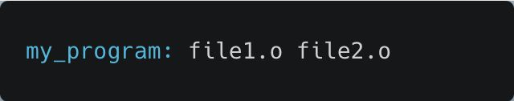
Makefiles Targets
The target is typically a file that the Makefile is tasked with creating or updating.
In most cases, this is an executable file (such as my_program) or an object file (such as file.o).
A target can also be a “phony target”, which doesn't correspond to a file, but instead represents a label for a command to be run (e.g., clean).
Here, my_program is the target, and it is dependent on the object files file1.o and file2.o.

Slide 12
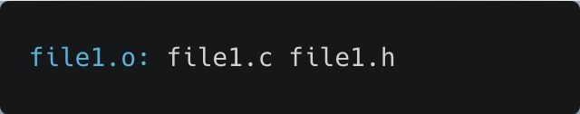
Makefiles Dependencies
Dependencies are the files that the target depends on.
If any of the dependency files have changed since the last time the target was made, the target will be rebuilt.
These dependencies are listed after the target, separated by a colon.
In this case, file1.o depends on file1.c and file1.h. If either of those files changes, file1.o will be rebuilt.

Slide 13
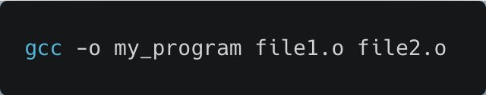
Makefiles Actions
The actions (also called commands or recipes) are the steps that make will execute to create or update the target.
These lines must begin with a tab character, not spaces.
The most common action is a compilation command, but it could be anything that processes the dependencies.
This command tells make to compile the object files into the final executable my_program.

Slide 14
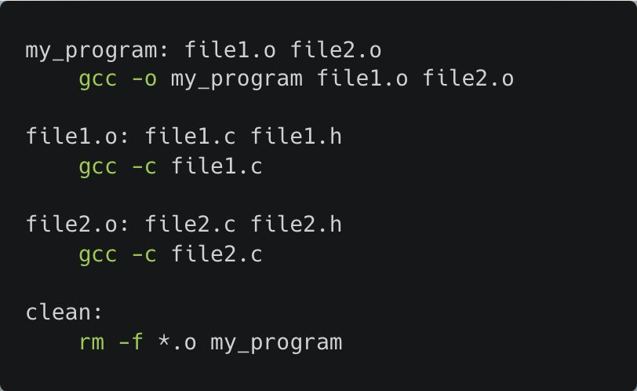
Makefiles
my_program is the target.
file1.o and file2.o are dependencies for the
my_program target.
gcc -o my_program file1.o file2.o is the
action to build the target.
clean is a phony target that removes compiled files.
How it works:
When you run make, it checks if my_program is up to date.
If any dependency (e.g., file1.c) is newer than
file1.o, it rebuilds file1.o.
If my_program is older than any .o file, it runs the action to create my_program using gcc.

Slide 15
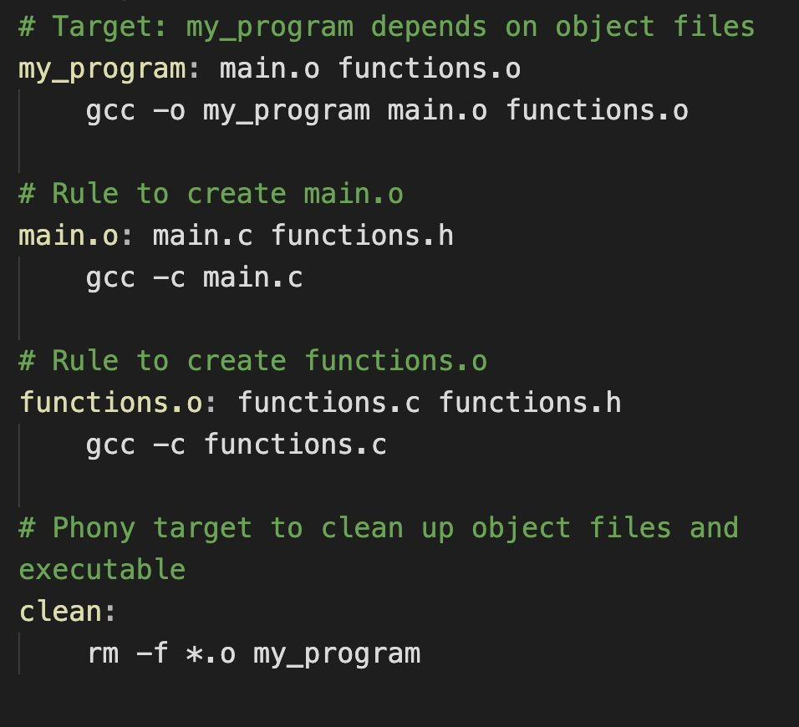
Makefiles
Target
my_program: The executable my_program is built from main.o and functions.o.
Dependencies:
my_program depends on the object files main.o and
functions.o.
main.o depends on main.c and functions.h.
functions.o depends on functions.c and functions.h.
Actions (commands):
gcc -c main.c: Compiles main.c into main.o.
gcc -c functions.c: Compiles functions.c into
functions.o.
gcc -o my_program main.o functions.o: Links the object files to create the final executable my_program.
Phony target clean:
This is used to remove compiled files (object files and executable) by typing make clean.

Slide 16
Makefiles
Target
my_program: The executable my_program is built from main.o and functions.o.
Dependencies:
my_program depends on the object files main.o and
functions.o.
main.o depends on main.c and functions.h.
functions.o depends on functions.c and functions.h.
Actions (commands):
gcc -c main.c: Compiles main.c into main.o.
gcc -c functions.c: Compiles functions.c into
functions.o.
gcc -o my_program main.o functions.o: Links the object files to create the final executable my_program.
Phony target clean:
This is used to remove compiled files (object files and executable) by typing make clean.
This simple Makefile automates the process of compiling and linking your program. It ensures that only the necessary parts are recompiled when you make changes, making the build process efficient.
make
./my_program make clean

Slide 17
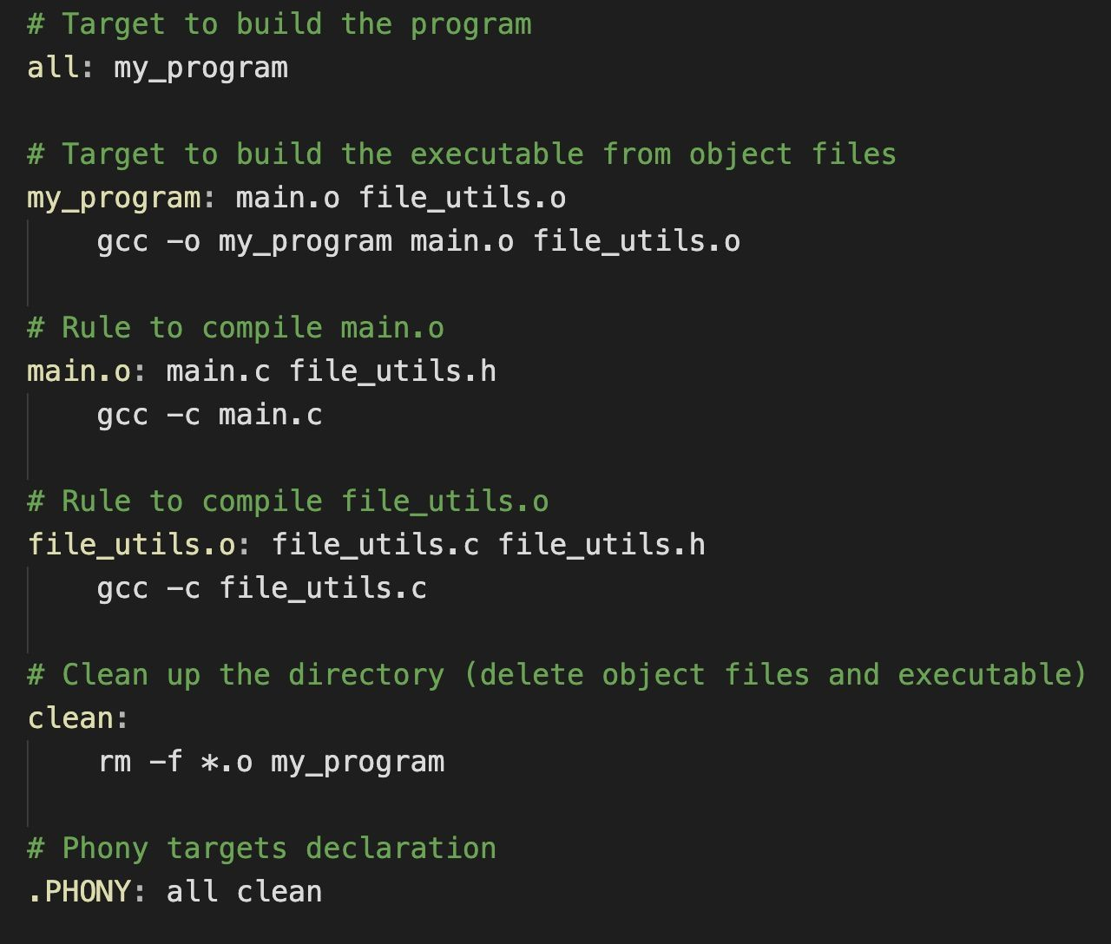
Makefiles
Common Targets
all Target
The all target is a phony target and acts as the default target. This means that when you run make (without specifying any target), make will default to building the all target.
In this case, all depends on the target my_program, so it will ensure that the my_program executable is built.

Slide 18
Makefiles Common Targets
clean Target
The clean target is a phony target that removes all generated files, such as object files (*.o) and the my_program executable.
It is useful to clean up the working directory, especially when you want to recompile everything from scratch.
all and clean are phony targets because they don’t correspond to actual files that make will create or update. Adding .PHONY tells make that these are not real files, but labels for commands.
This ensures that make doesn't get confused if a file named clean or all happens to exist in the directory.

Slide 19
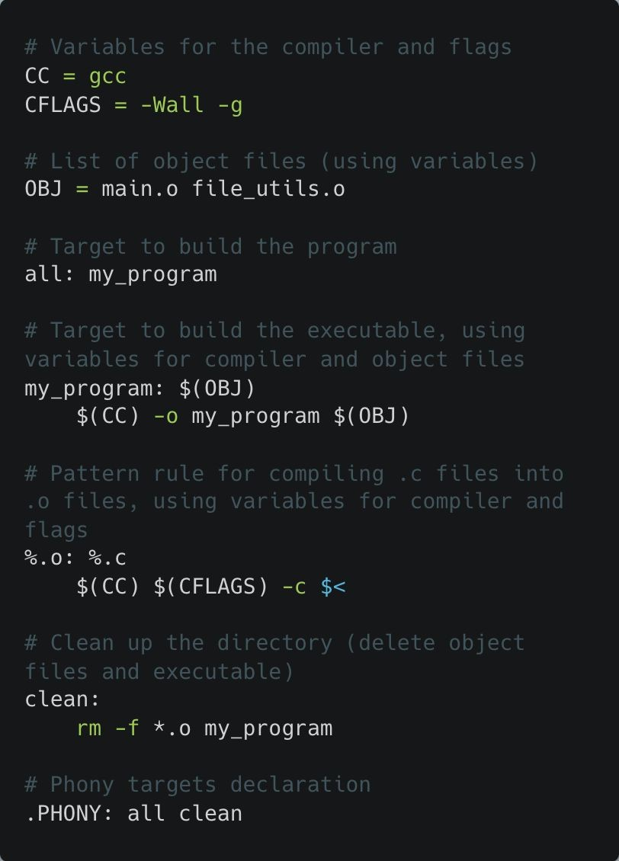
Makefiles Variables and Pattern Rules
Variables in Makefiles
Variables allow you to store values (like compiler commands, flags, file lists, etc.) and reuse them throughout the Makefile. This makes it easier to change the value in one place rather than in multiple locations.
CC = gcc: This defines the CC variable to represent the compiler (gcc in this case).
CFLAGS = -Wall -g: This defines the CFLAGS variable for the compilation flags. -Wall enables all compiler warnings, and -g includes debugging information.
OBJ = main.o file_utils.o: This variable stores a list of object files that are needed to build the final program.
Instead of hardcoding the compiler and flags everywhere, you use the variables $(CC) and $(CFLAGS), making it easier to maintain and modify.

Slide 20
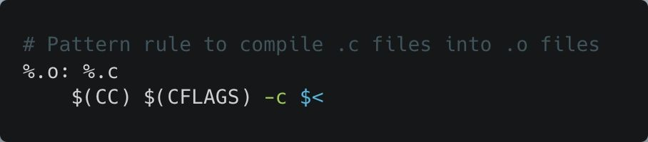
Makefiles Variables and Pattern Rules
Pattern Rules
Pattern rules allow you to define generic rules that apply to multiple files.
The % symbol acts as a wildcard and matches any string.
%.o: %.c: This is a pattern rule that says, "for every .o file, there should be a corresponding .c file with the same name."
For example, main.o will be generated from main.c, and file_utils.o will be generated from
file_utils.c.
$<: This is an automatic variable that refers to the first dependency, which is the .c file in this case. So, when compiling main.o, $< would be main.c.
This pattern rule will automatically apply to any .c file in the project, without the need to write separate compilation rules for each one.

